Slide 1

Business Analyst Career Program - Capstone Project
- By Harsh Matra

Slide 2
Agenda
Data Exploration
Statistical Analysis using Excel
Graphical Analysis using Excel
Insert the given data into the SQL server
Import the Data from the SQL Database into PowerBI
Interactive Dashboard by using visualization tools
Conclusion and Inferences
Endnotes

Slide 3
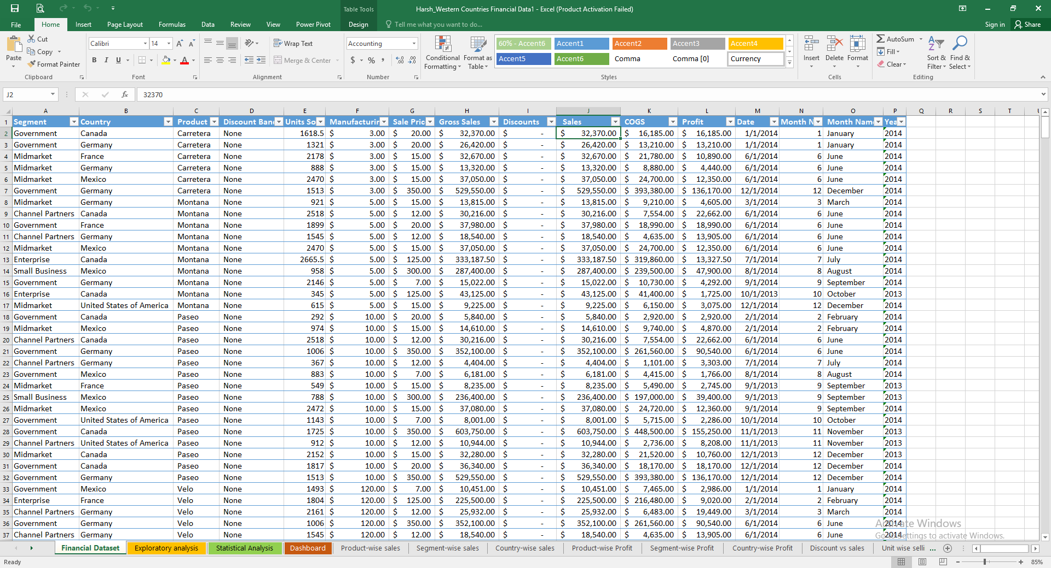
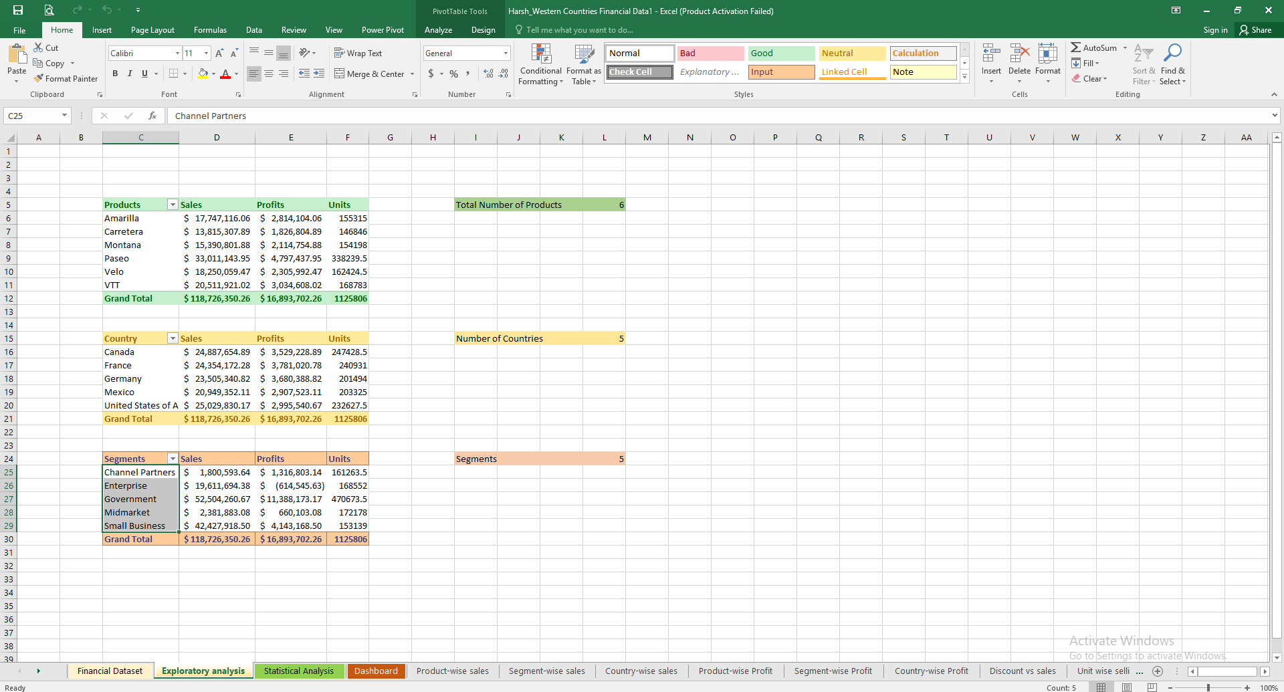
Firstly I did an exploratory analysis and calculated the essential quantities
There are 6 types of products which were sold across 5 countries within 5 segments from the given dataset.

Slide 4
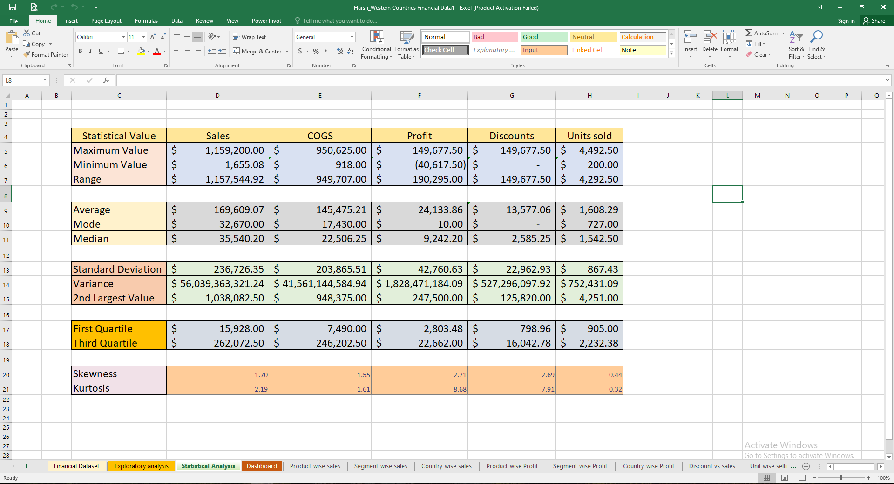
Here is the Statistical Analysis where I calculated all values of statistical tools.

Slide 5
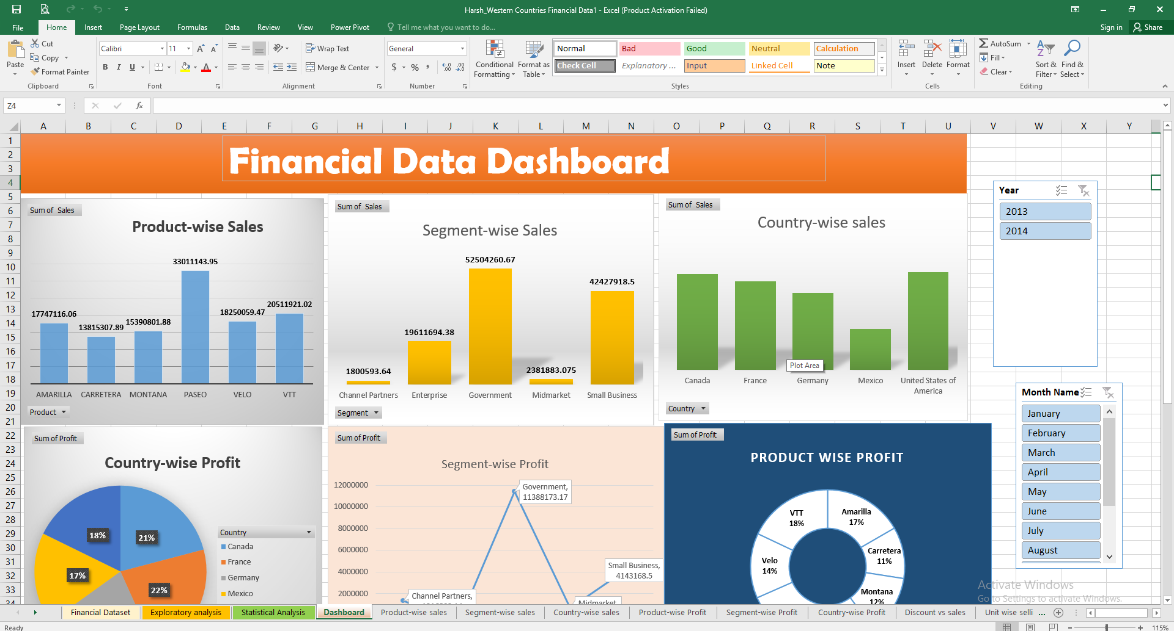
In Graphical Analysis, I tried to make all the required charts from which we can get a clarity about the financial dataset.

Slide 6
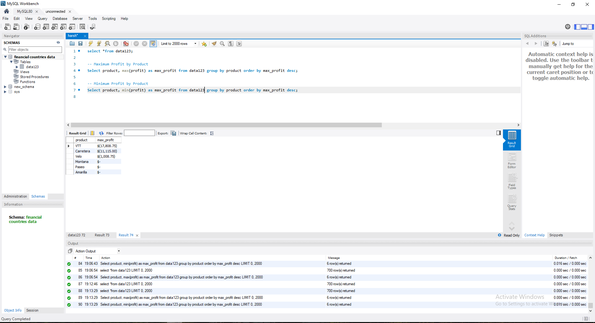
After I imported excel data into MySQL and performed some basic queries to find maximum and minimum profit by a product.

Slide 7
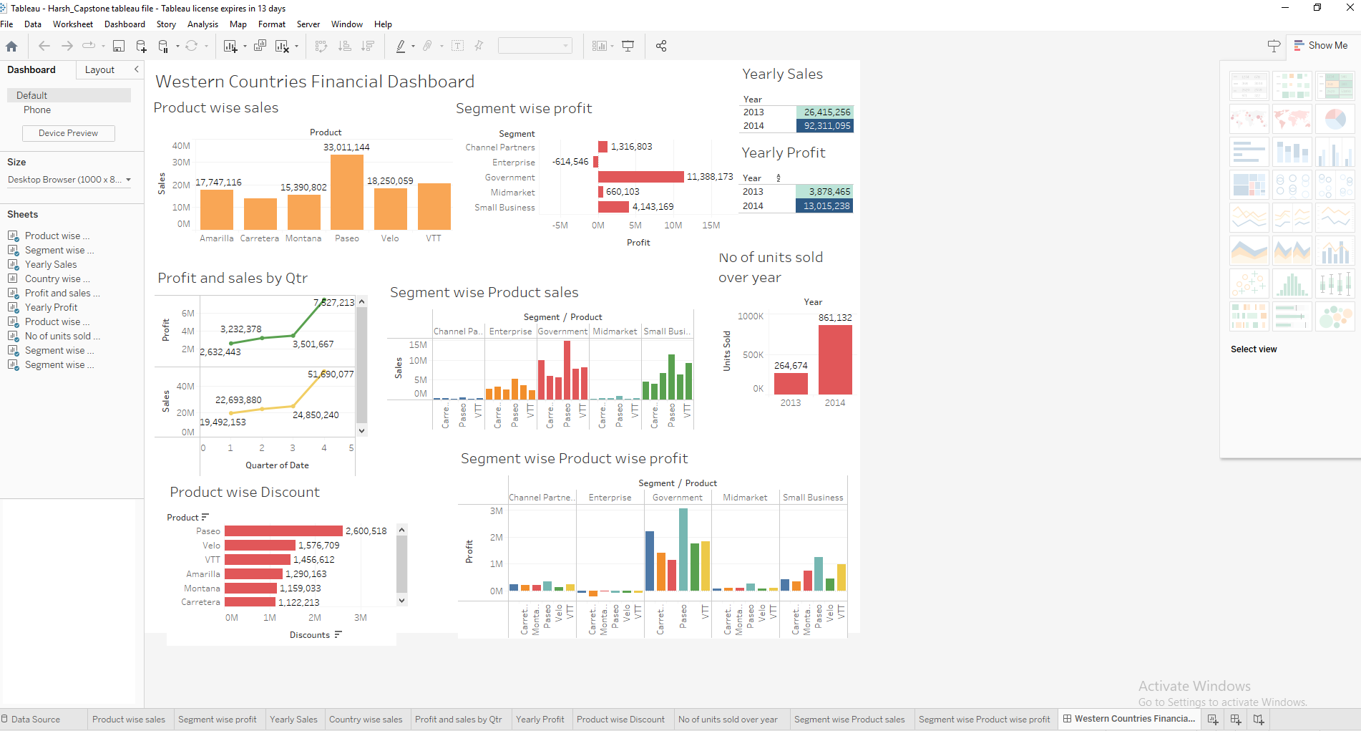
Then I imported that data into Tableau and made the dashboard to solve questions given to solve the project

Slide 8
The given dashboard has
➔ Product wise Sales
➔Segment wise Profit
➔Yearly sales
➔Country wise Sales
➔ Profit and sales by Qtr.
➔ Yearly profit
➔ Product wise discount
➔ No. of units sold year over year
➔ Segment wise Product Sales
➔ Segment wise product wise profit
➔ Top 2 countries
As we can see revenue wise USA and Canada has highest sales
While France and Germany has highest profit share.
➔ Bottom 3 products-
Carretera, Montana, Velo

Slide 9
Thank You

Slide 10
Inference:
Paseo is the most sold product.
Government segment accounts for highest number of sales.
USA has highest number of sales.
Paseo yields more profit 28% share as it has more sales.
As countries have most sales in Government , they have more profit from this segment.
Meanwhile there is loss in Enterprise sector- Countries need to discontinue business in this segment.
France and Germany account for 22% profit - Highest.
As there is slight increase in discount, it results in increase in sales.
October month accounts for highest sales.

